Slide 1

HEALTH INFORMATION SYSTEM
Software Engineering Internship Task
NAME: Lincoln Madaraka DATE: 26TH APRIL 2025
madarakalincoln48@gmail.com

Slide 2
OBJECTIVES
Build a basic health information management system.
Allow doctors to manage clients and health programs.
Enable external systems to access client data via API.

Slide 3
Features
Health Programs (createing viewing and managing).
Client Enrollment into Health Programs.
1
3
2
Client Registration.
4
Client Profile Viewing (with enrolled programs)

Slide 4
Technologies
Backend: Django; Python.
Frontend: Bootstrap, Javascript, HTML, CSS
Database: SQLite
Hosting: Render

Slide 5
System Architecture
- HealthInformationSystem/ (Main Django project)
- health/ (App inside project)
- manage.py
- db.sqlite3
- staticfiles/
- requirements.txt
- Procfile

Slide 6
System Architecture (cont.d)
HealthInformationSystem/ — Main Django project folder, contains settings and configurations.
health/ — Django app handling models, views, templates for clients and health programs.
manage.py — Django command-line utility for running the server and managing the project.
db.sqlite3 — SQLite database file storing clients, programs, and enrollments.
staticfiles/ — Directory for static assets like CSS, JavaScript, and images.
requirements.txt — List of Python dependencies needed to run the project.
Procfile — Deployment file used to instruct hosting platforms (e.g., Render) how to run the app.

Slide 7
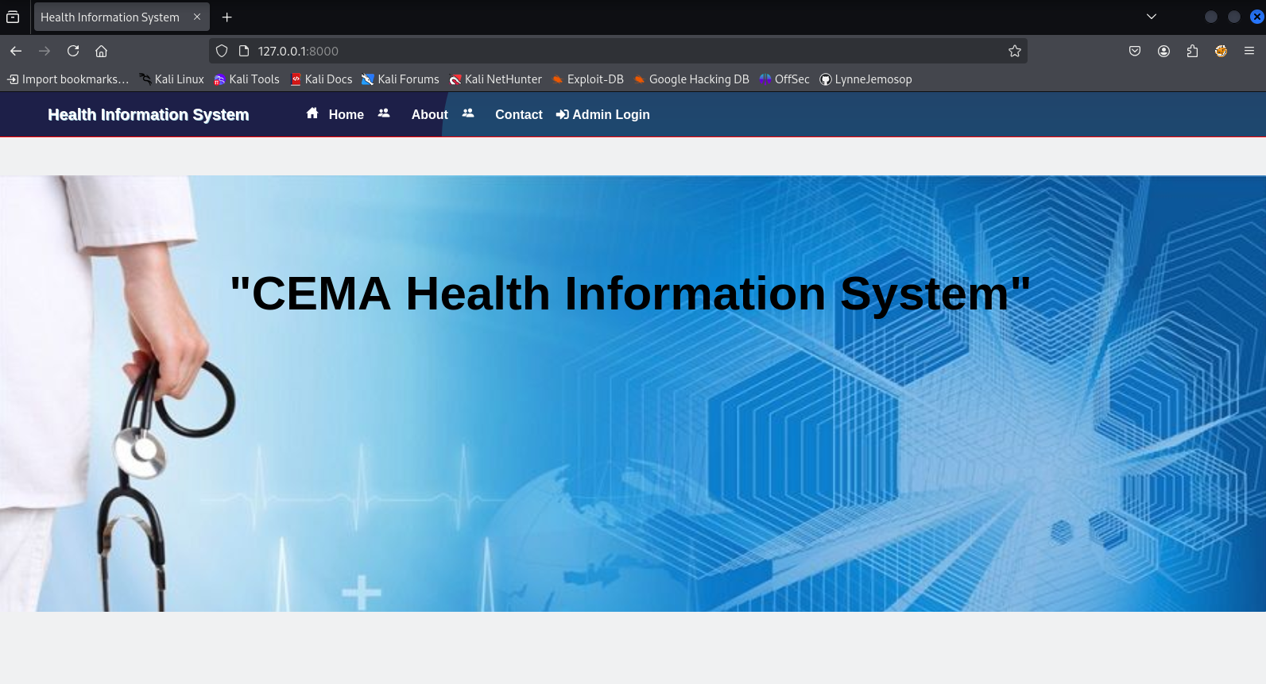
Homepage

Slide 8
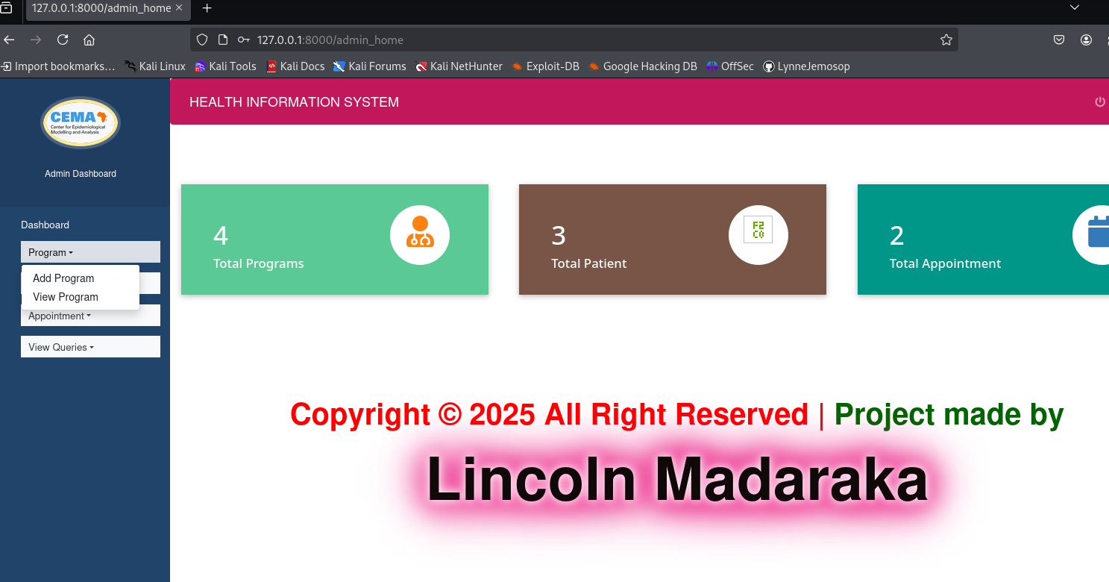
Program Registration

Slide 9
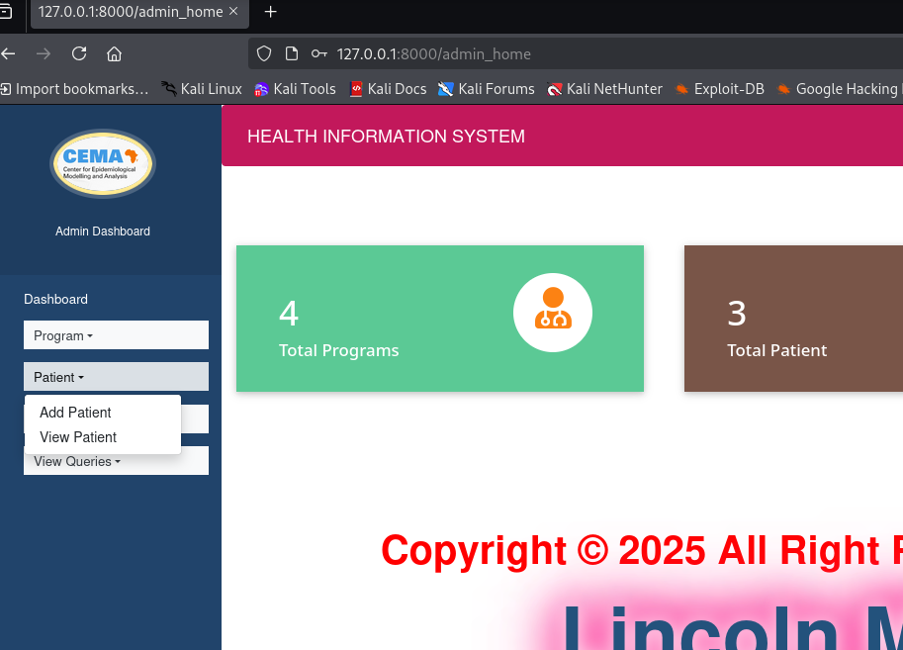
Client Registration

Slide 10
Approach & Design Decisions
Django: chosen for fast development and robustness.
Modular design: programs, clients, enrollment are separate models.
Security: Django CSRF protection used.
Clean organized code with comments and organization.

Slide 11
CONCLUSION
Summary: Successfully developed a functionaing health information system.
Skills demonstrated: software engineering, web development, API design.
Excited about opportunity to learn and contribute.

Slide 12
Thank you.

